Slide 1

DATATHON
Eric Chen, Kevin Wang, Kevin Zhu

Slide 2
Content
Q1: How did these provinces act differently in different stages of lockdown and re-opening?
Q2: How does Canada compared to other countries with respect to its outdoor visits?
Q3:Can you combine any additional resources to provide us with a unique finding?

Slide 3
Question 1

Slide 4
Stage 1
Region | Date
B.C. | May 6 – May 18
Manitoba | May 4 – May 31
Newfoundland and Labrador | May 11 – June 7
Ontario | May 19 – June 11
Saskatchewan | May 4 – May 19

Slide 5
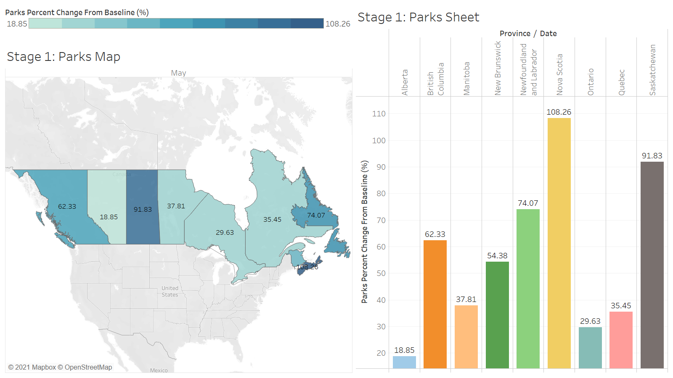

Slide 6
Stage 1 – Park
The mobility of park in each province were increased
All the provinces allowed park to reopen, except national park
The provincial parks in B.C. were still closed
Low risk in a larger area

Slide 7
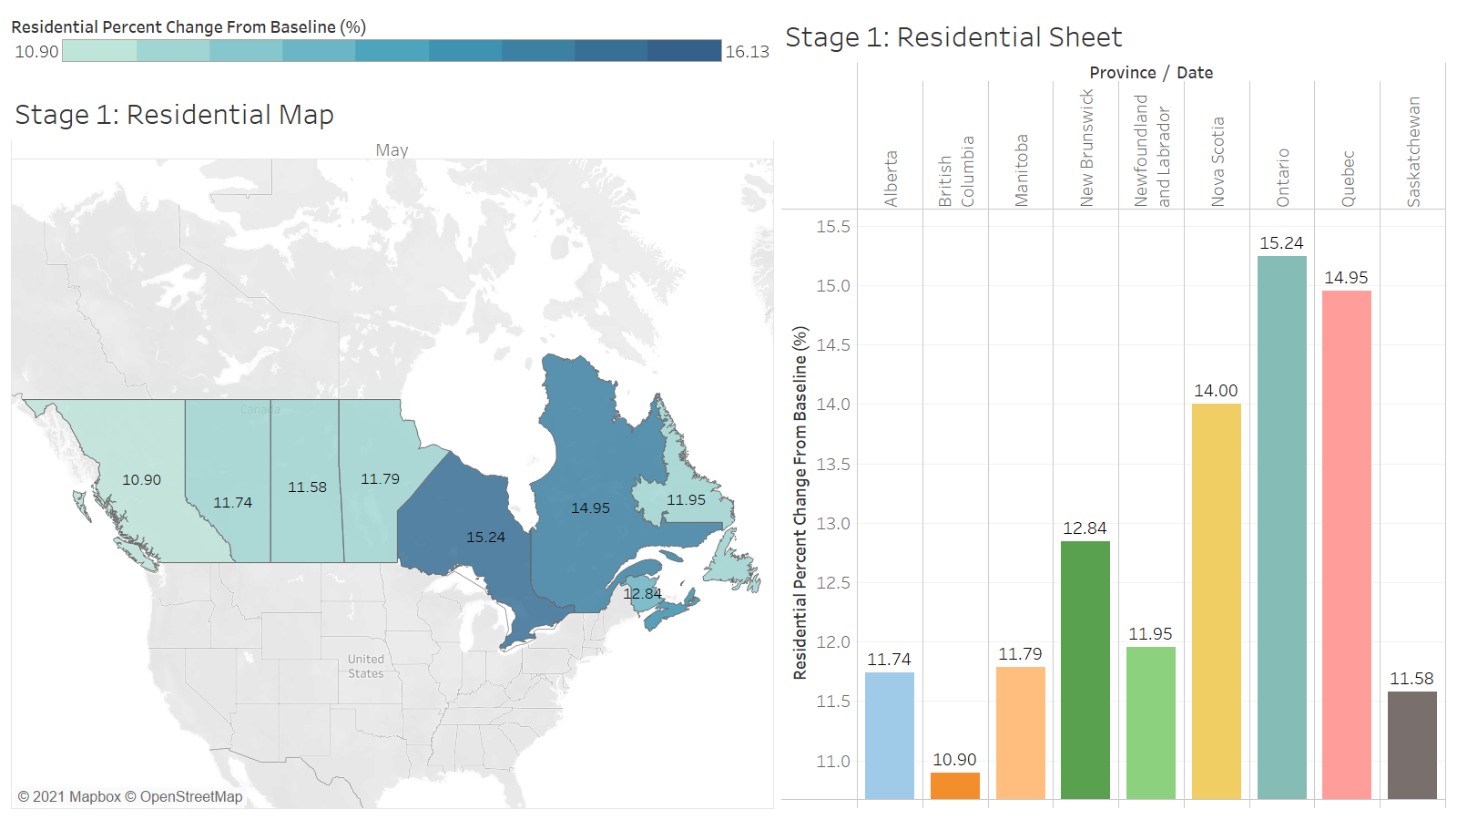

Slide 8
Stage 1 – Residential area
B.C
Ontario
No mandatory restriction to stay home learning
Reduce in-person class learning
Schools remained close, students were having online learning

Slide 9
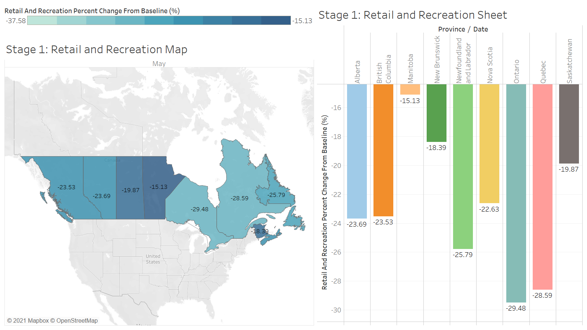

Slide 10
Stage 1 – Retail and Recreation
Manitoba
Ontario
Allow most retails to open under some certain restrictions
Reopen:
Jewelers;
Clothing Store;
Small Grocery Store; and
Similar Business
Recommend for car-side pick up

Slide 11
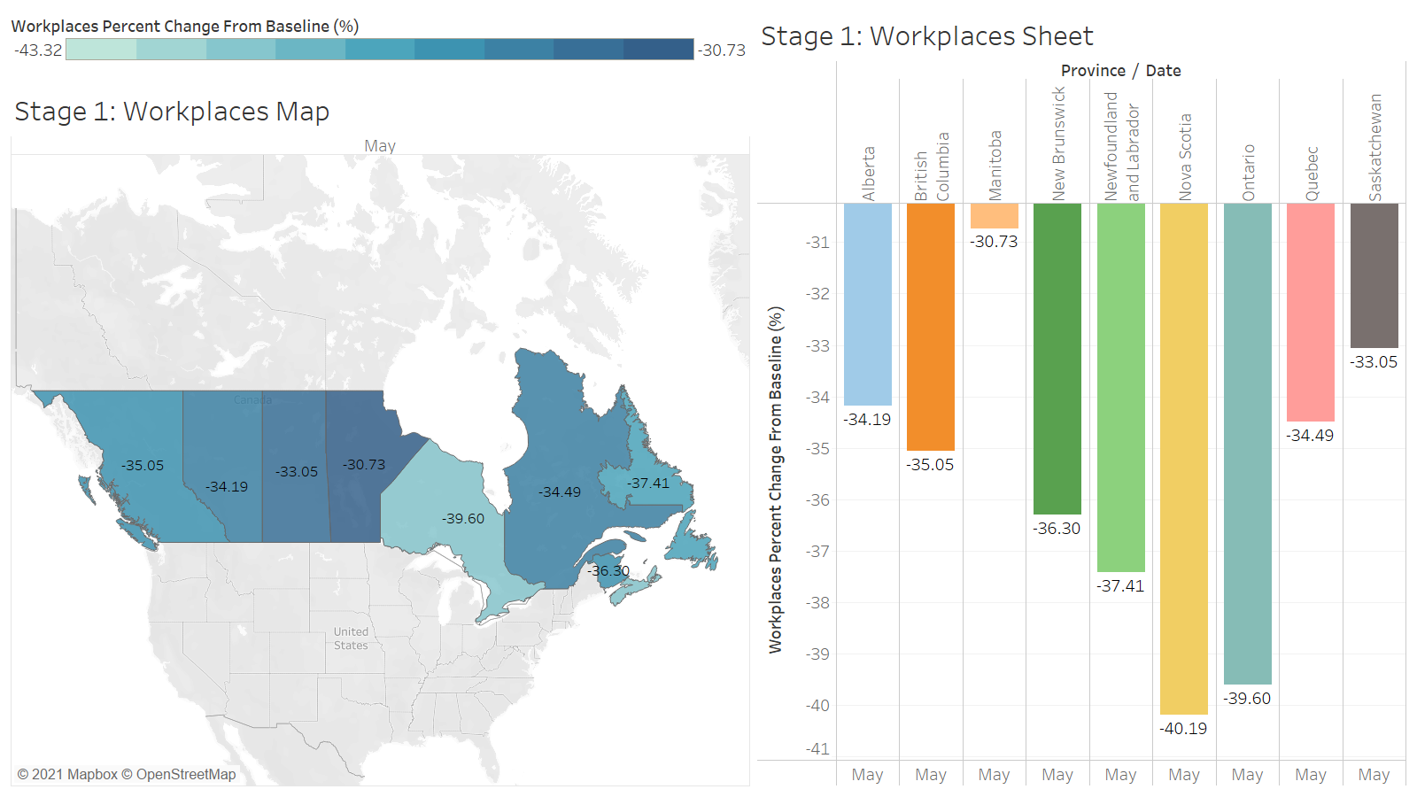

Slide 12
Stage 2
Region | Date
B.C. | May 19 – June 23
Manitoba | June 1 – June 20
Newfoundland and Labrador | June 8 – June 24
Ontario | June, 12 – July 16
Saskatchewan | May, 19 – June 7

Slide 13
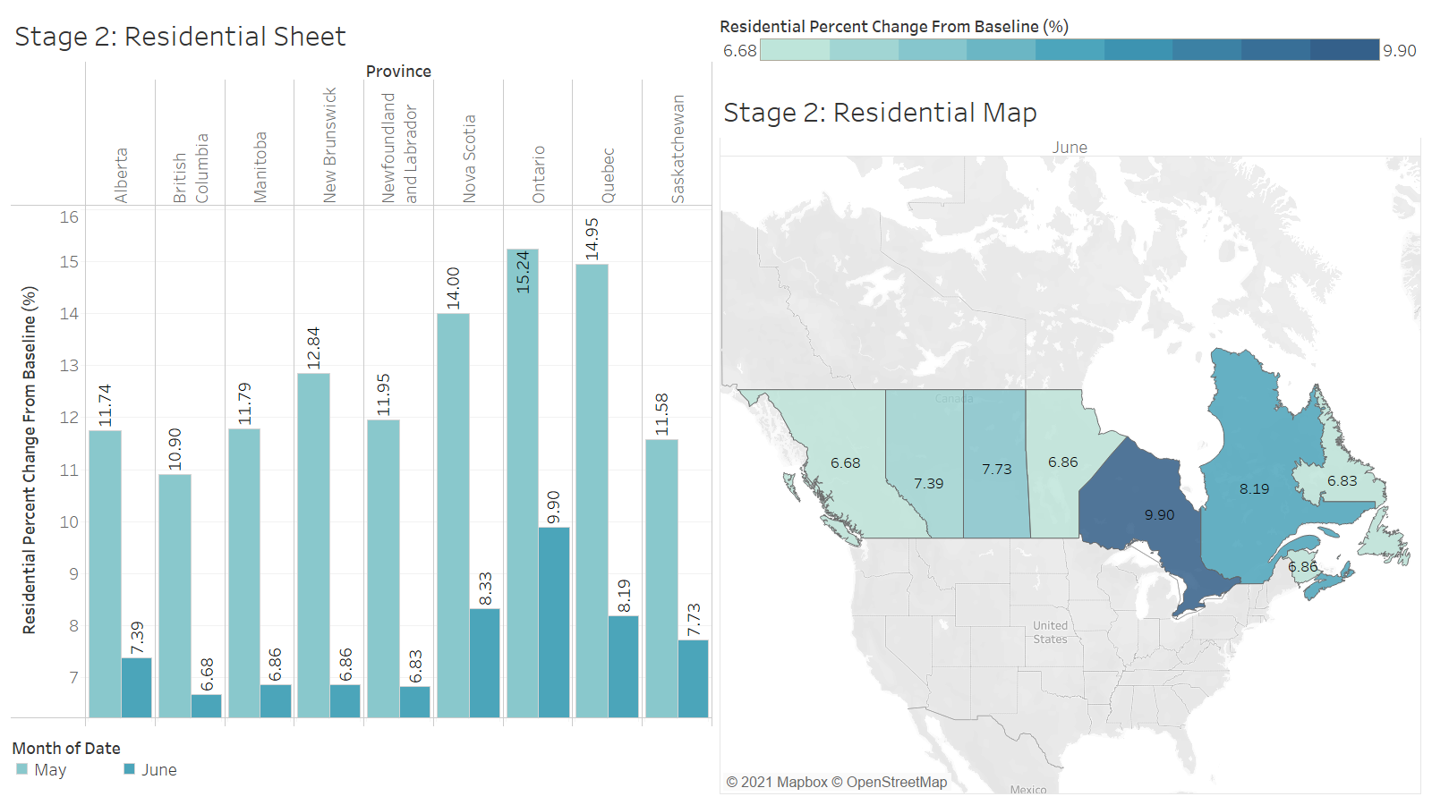

Slide 14

Stage 2 – residential Area
The mobility in residential area was decreased in each province
Decreasing in a range from 3.85% to 6.75%
People had more choices during stage 2 → might not always stay at home

Slide 15
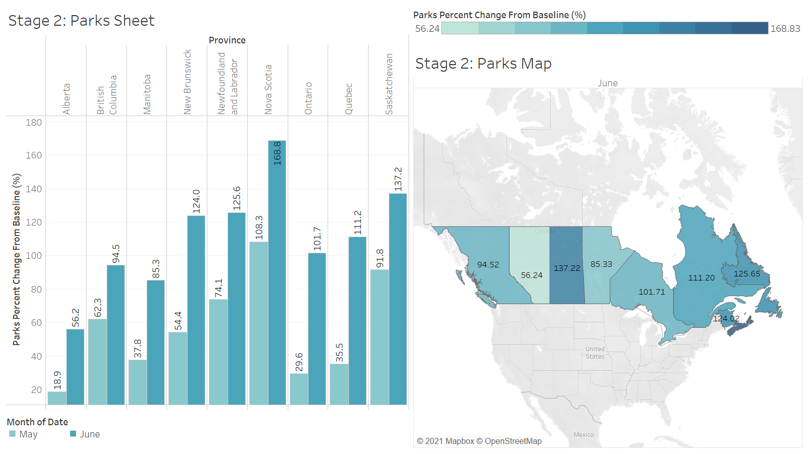

Slide 16
STAGE 2 – park
The mobility of park in each state were increased
Increasing in a range from 32.2% to 75.7%
As the pandemic was getting better, people would like to go out and take a walk

Slide 17
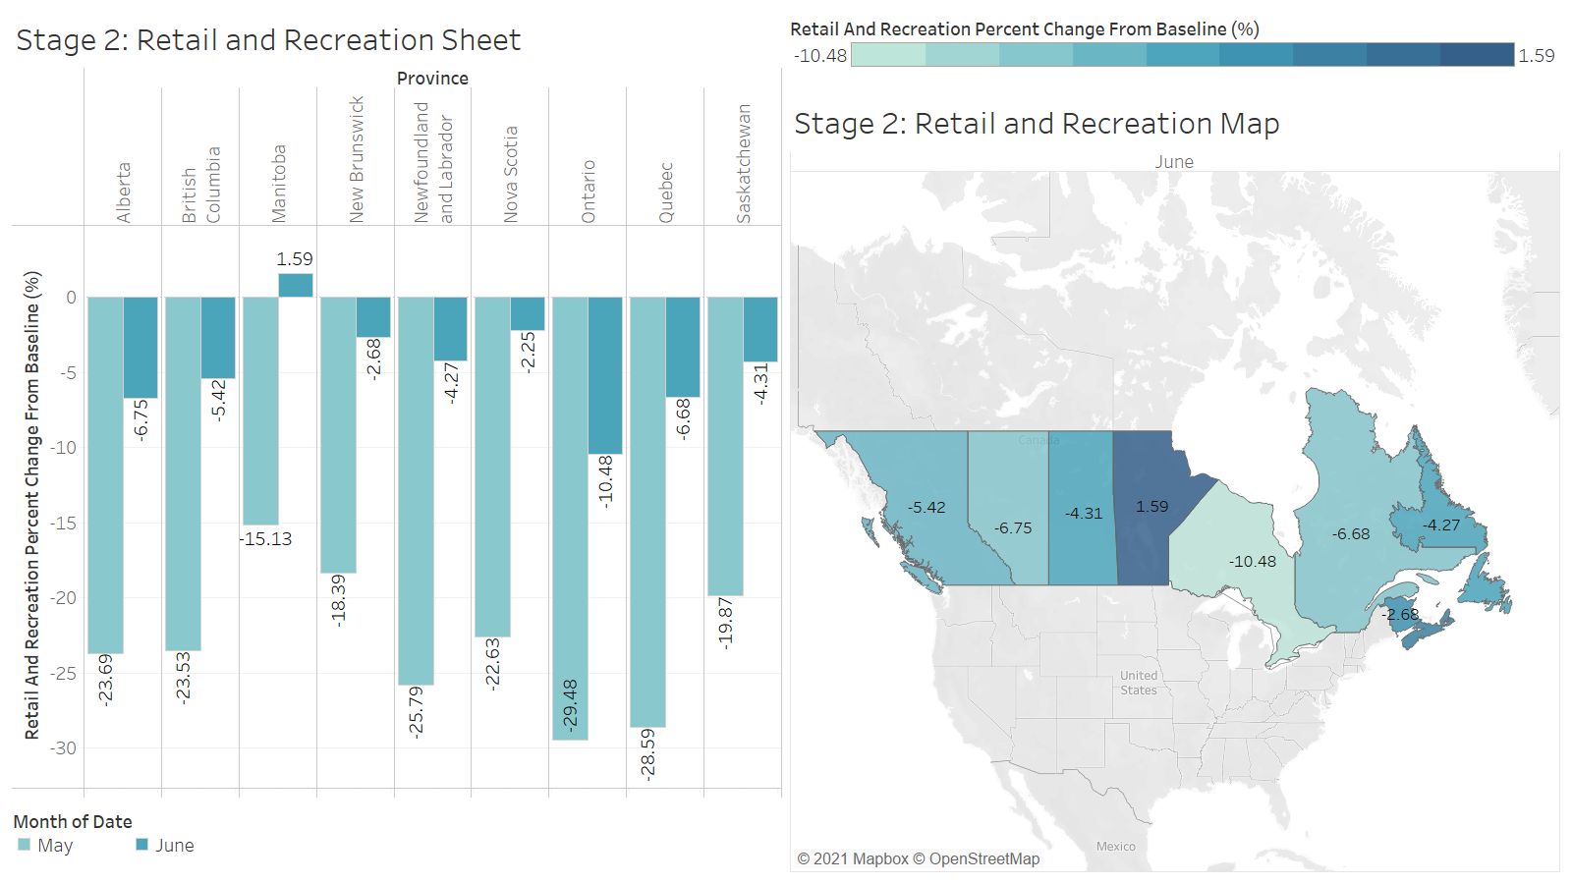

Slide 18
Stage 2 – retail and recreation
The mobility in retail and recreation was increase in each province
Increasing in a range from 15.65% to 21.91%
People have more choices to go out and have fun

Slide 19
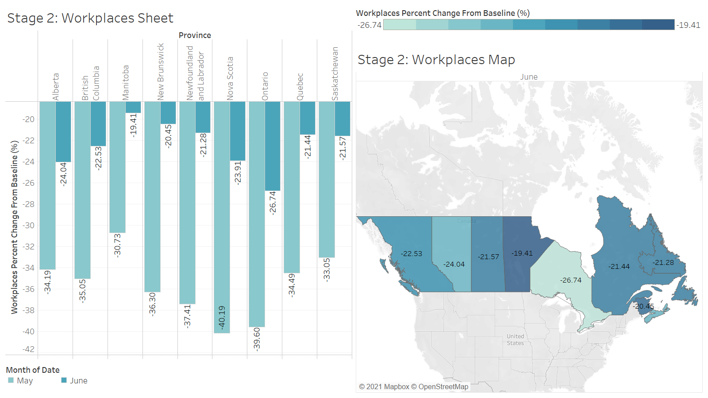

Slide 20
STAGE 2 – WORKPLACE
The mobility of transit station & workplace in each state were increased
Increase in a range from 4.98% to 34.51%
More and more people back to work during stage 2, instead of working online

Slide 21
Stage 3
Region | Date
B.C. | June, 24
Manitoba | June, 21
Newfoundland and Labrador | June, 25
Ontario | July, 17
Saskatchewan | June, 8

Slide 22
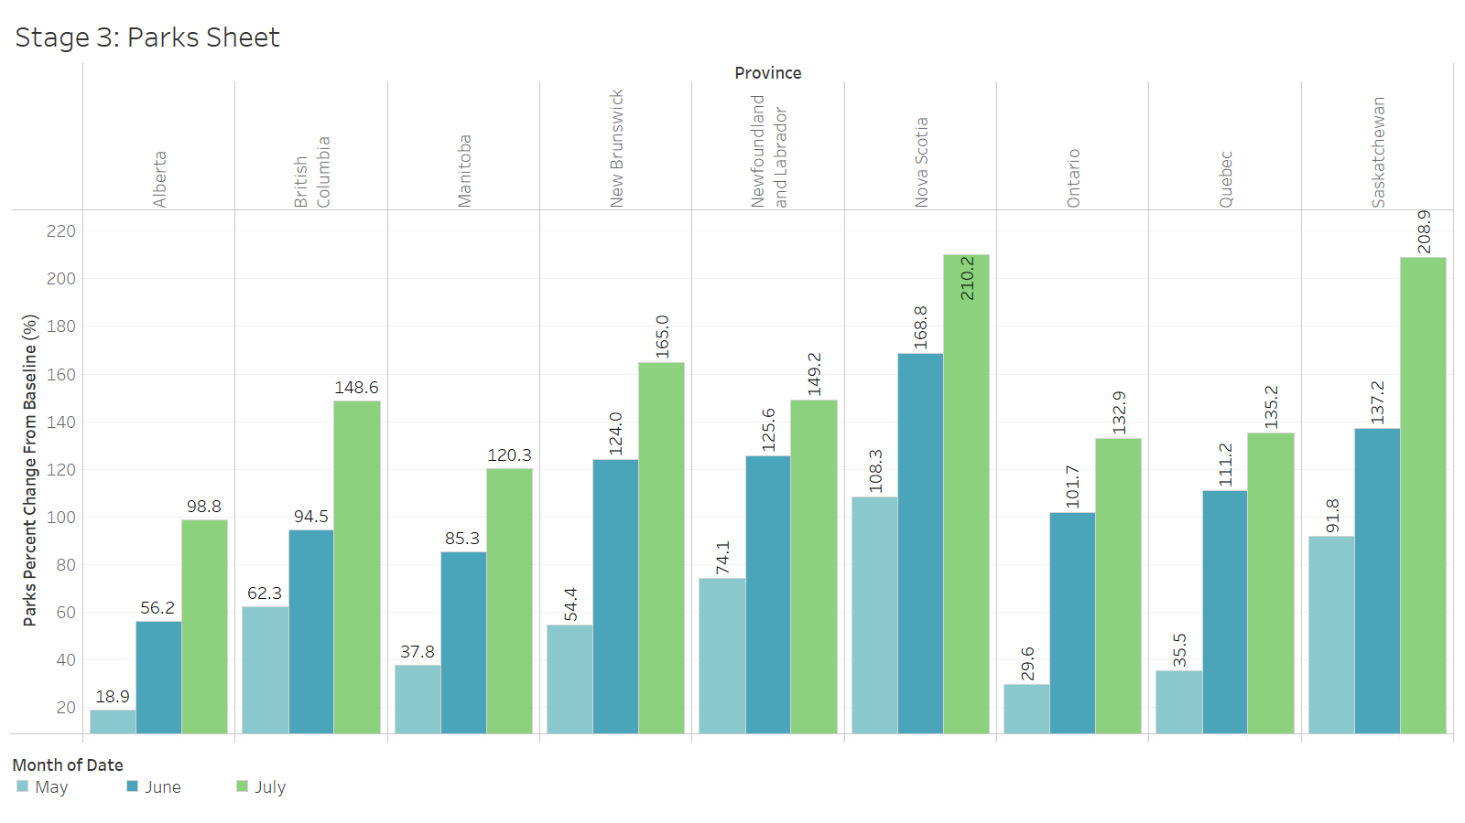

Slide 23
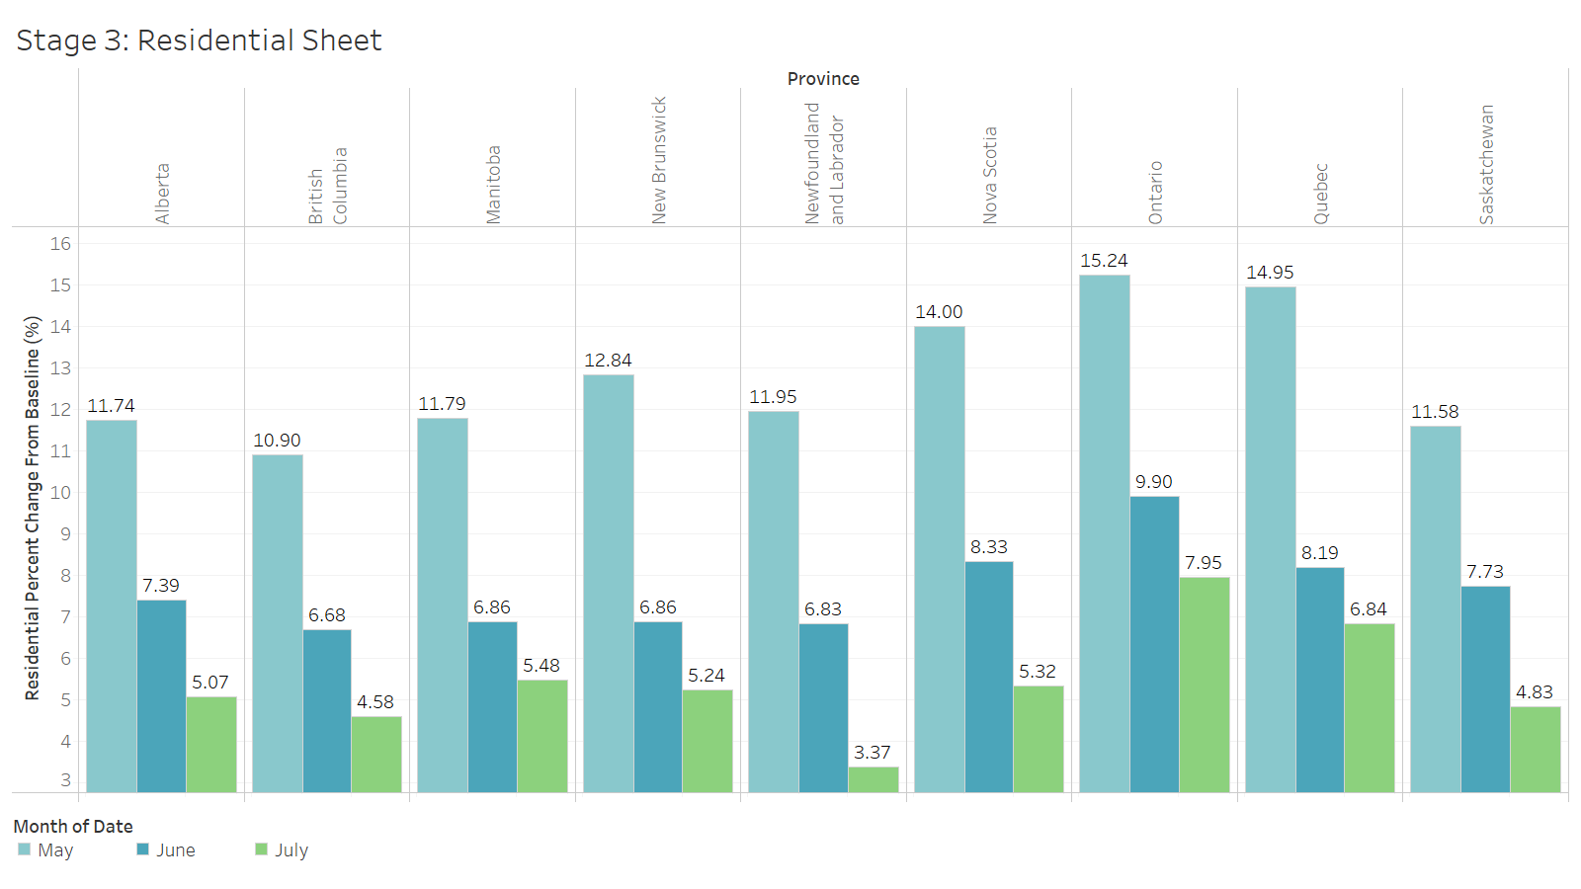

Slide 24
STAGE 3 - parks
The mobility of parks in stage 3 were all increased
Comparing to baseline, the mobility had more than double than the baseline
People were more likely to go to park, instead of shopping
The restriction for parks from government was the least

Slide 25
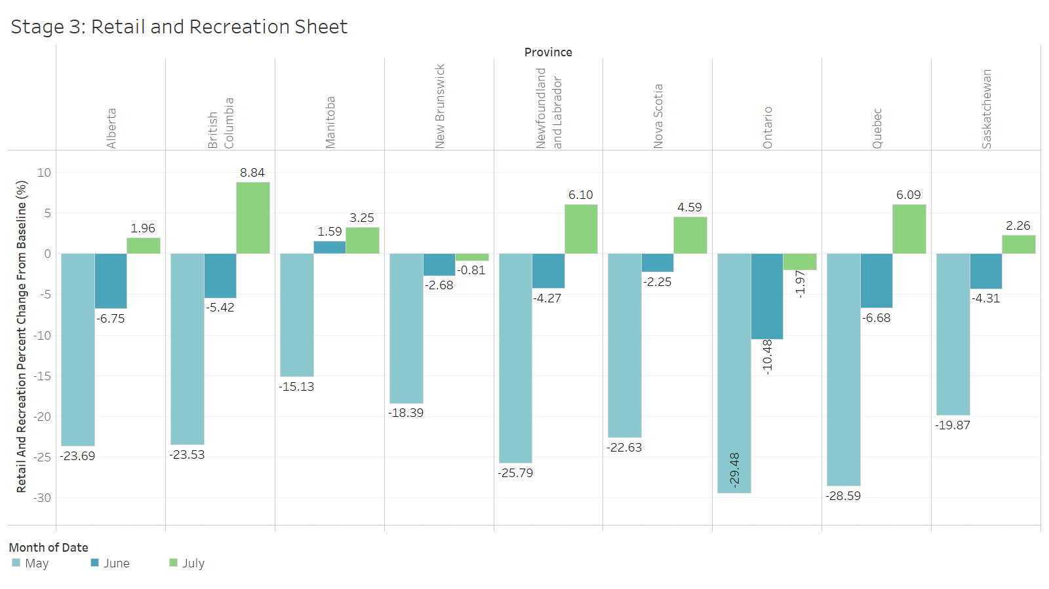

Slide 26
Stage 3 – Retail and recreation
As transit station had higher mobility, then retail and recreation will also have the high mobility

Slide 27
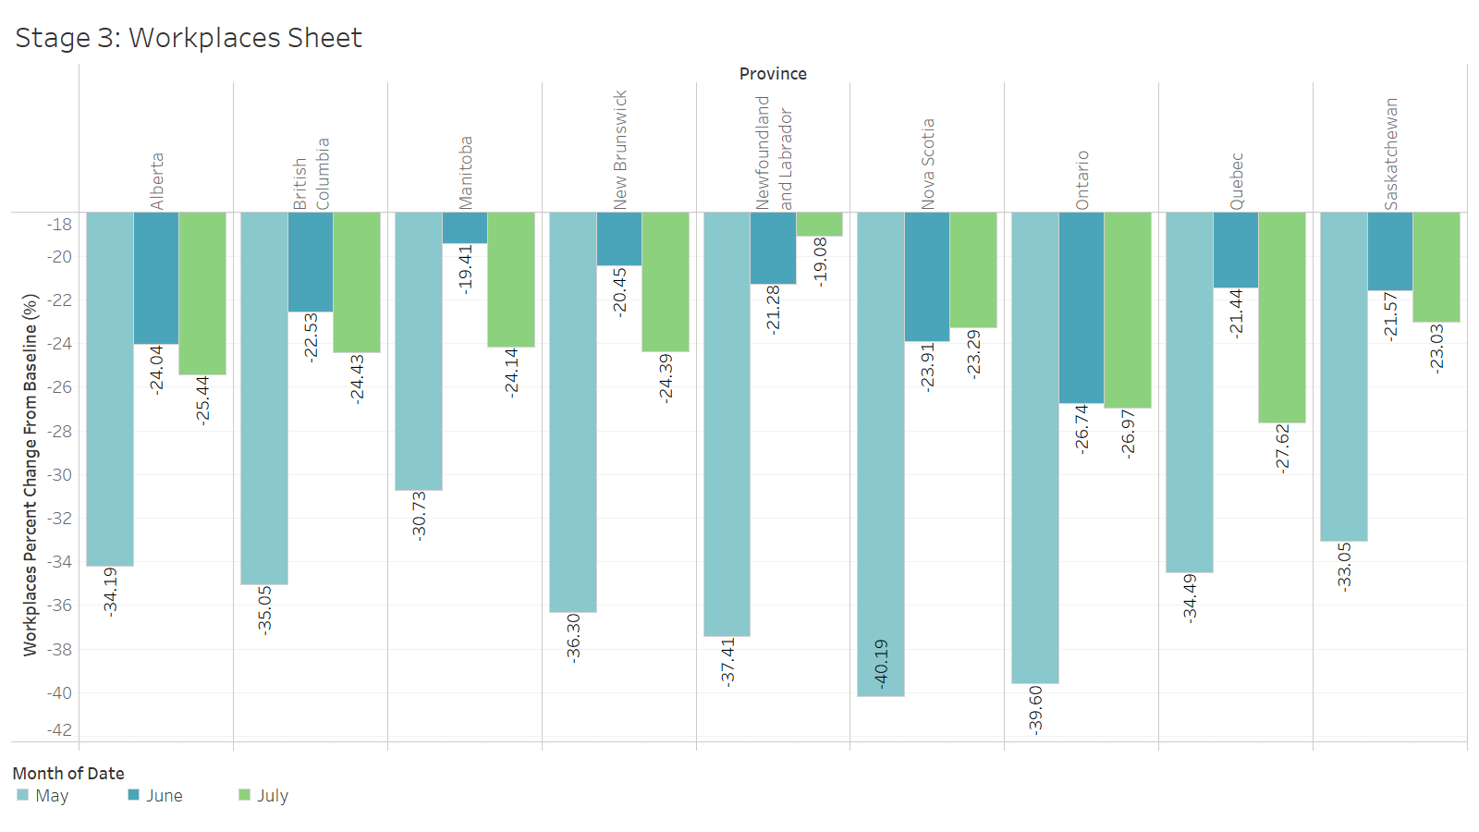

Slide 28
Stage 3 – workplace
The mobility in the workplace in most of the province increases then decreases except Newfoundland and Labrador is decreasing all the way.

Slide 29
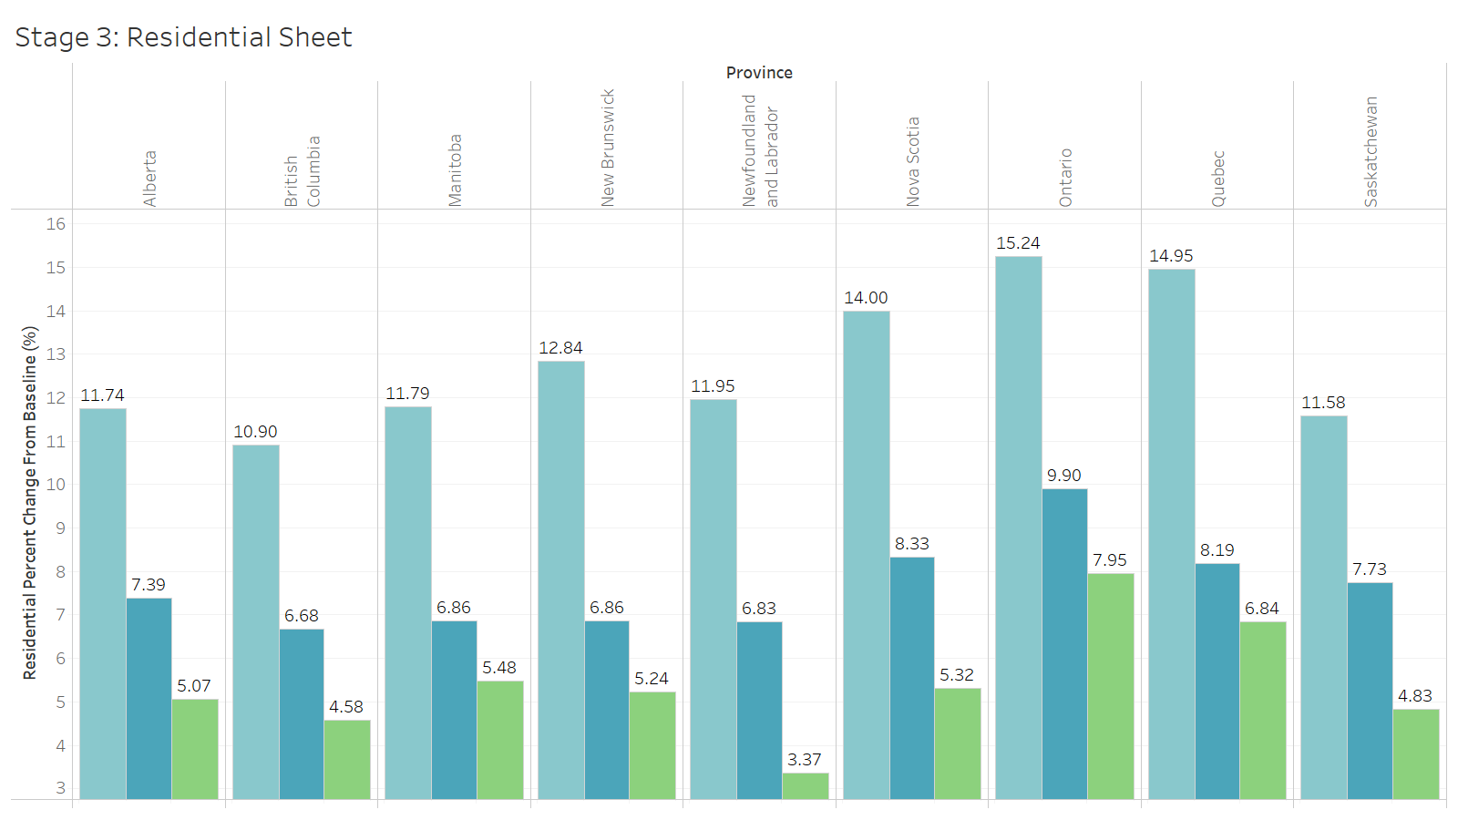

Slide 30
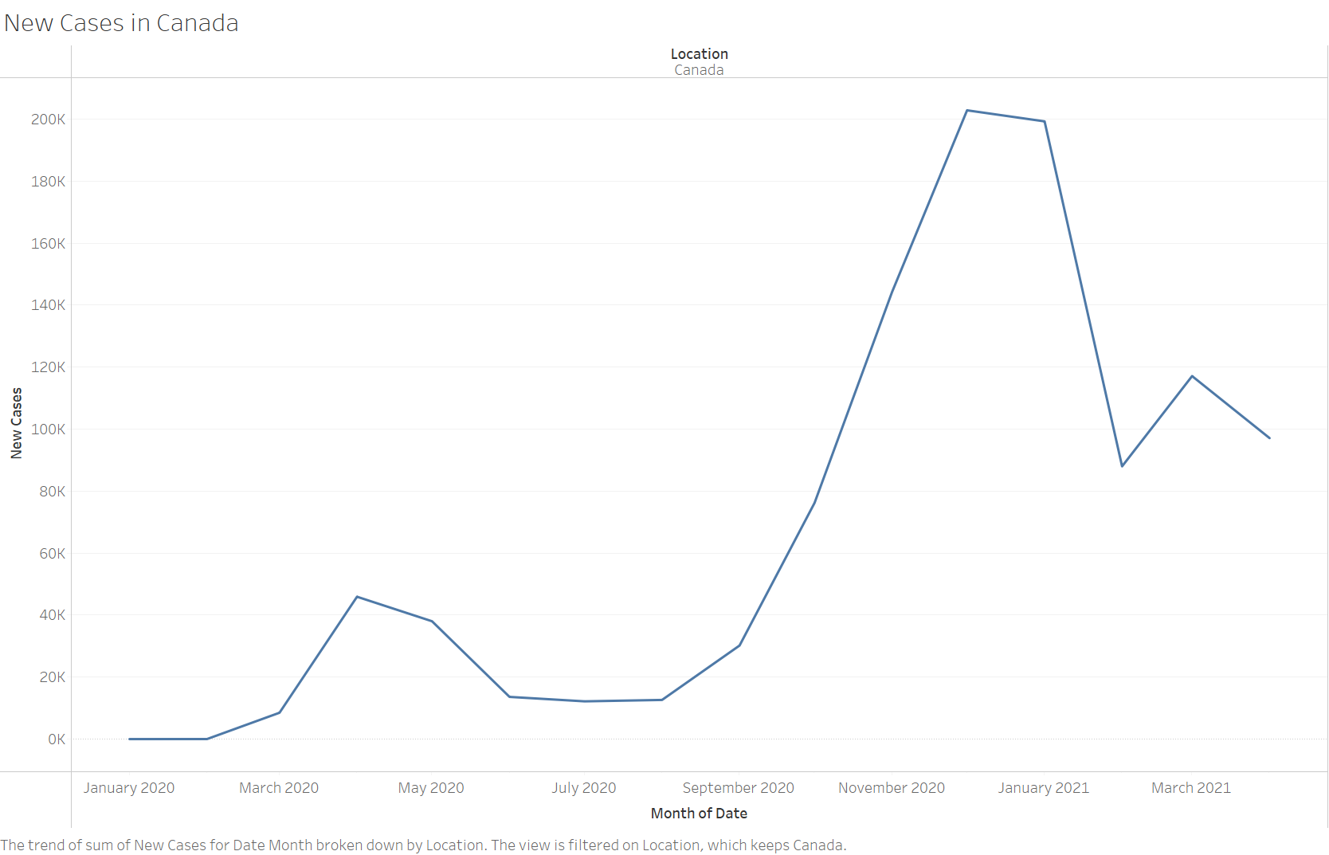
Stage 3 – residential Area
The mobilities in residential were gradually decrease toward the baseline
In stage 3, the number of new cases in Canada were dropped in the lowest point
If the cases getting lower and lower, the restrictions for resident will be less

Slide 31
Question 2

Slide 32
COUNTRIES
CANADA
THE US
SOUTH KOREA
BRAZIL

Slide 33
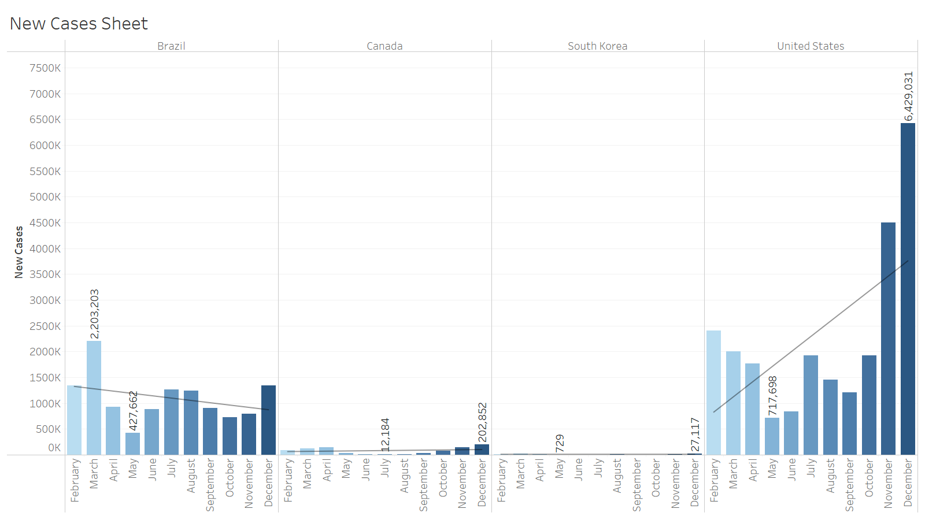

Slide 34
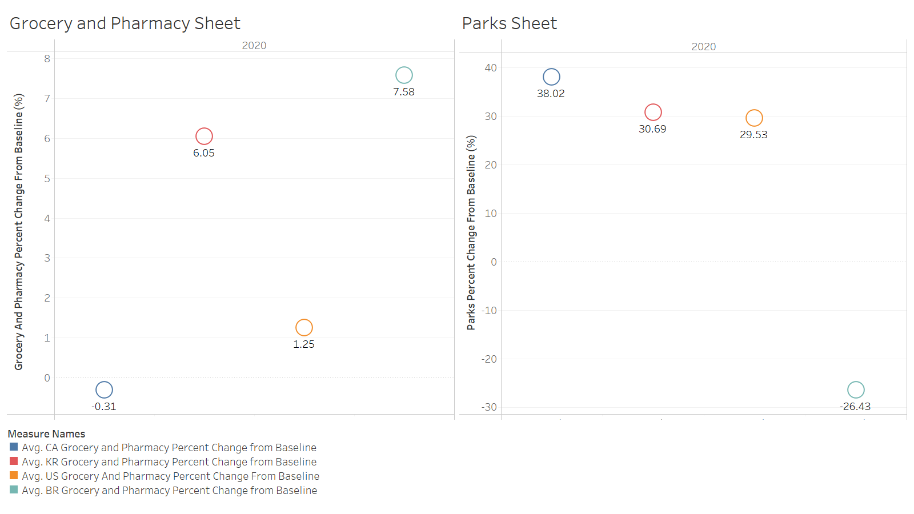

Slide 35
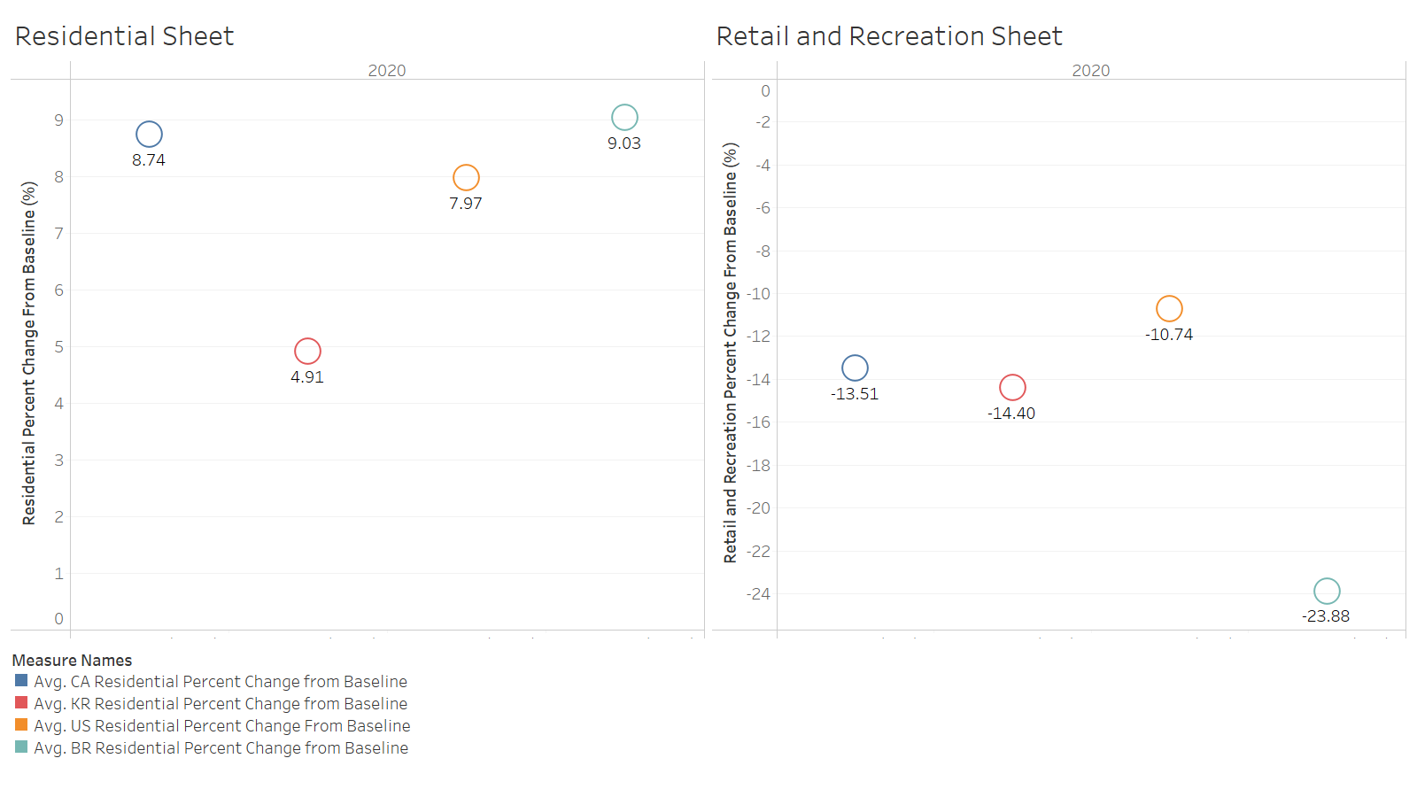
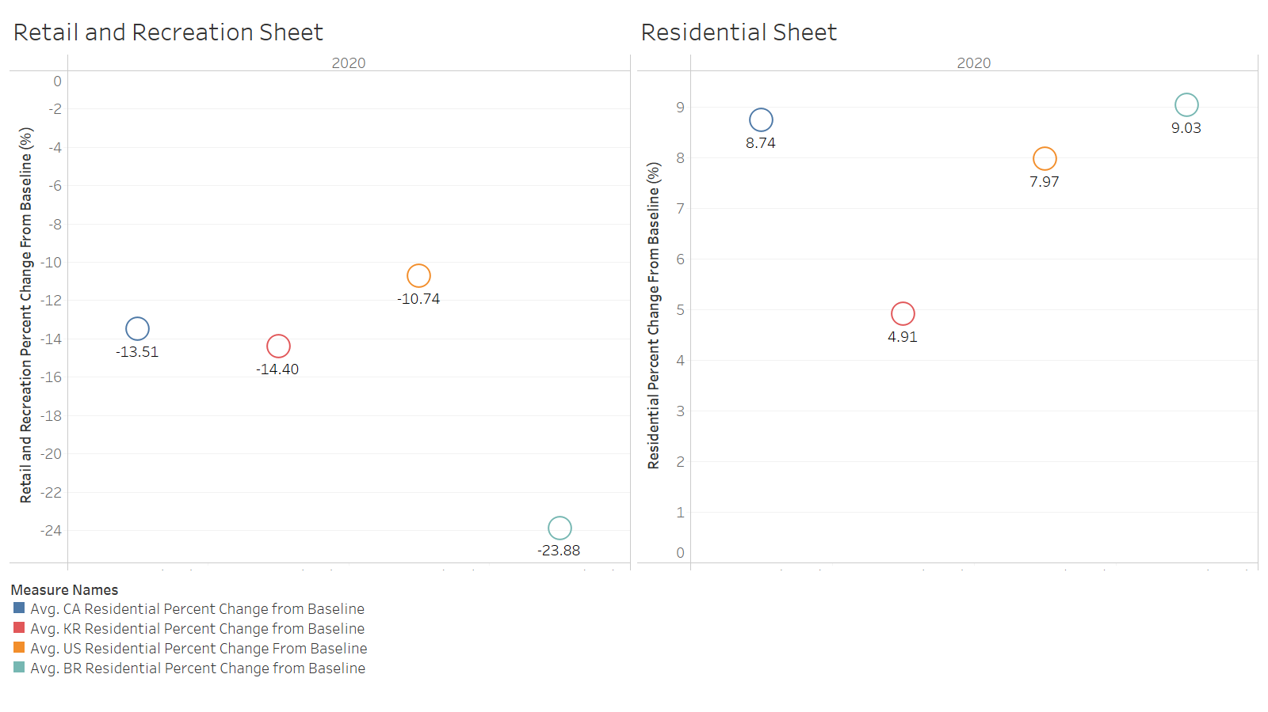

Slide 36
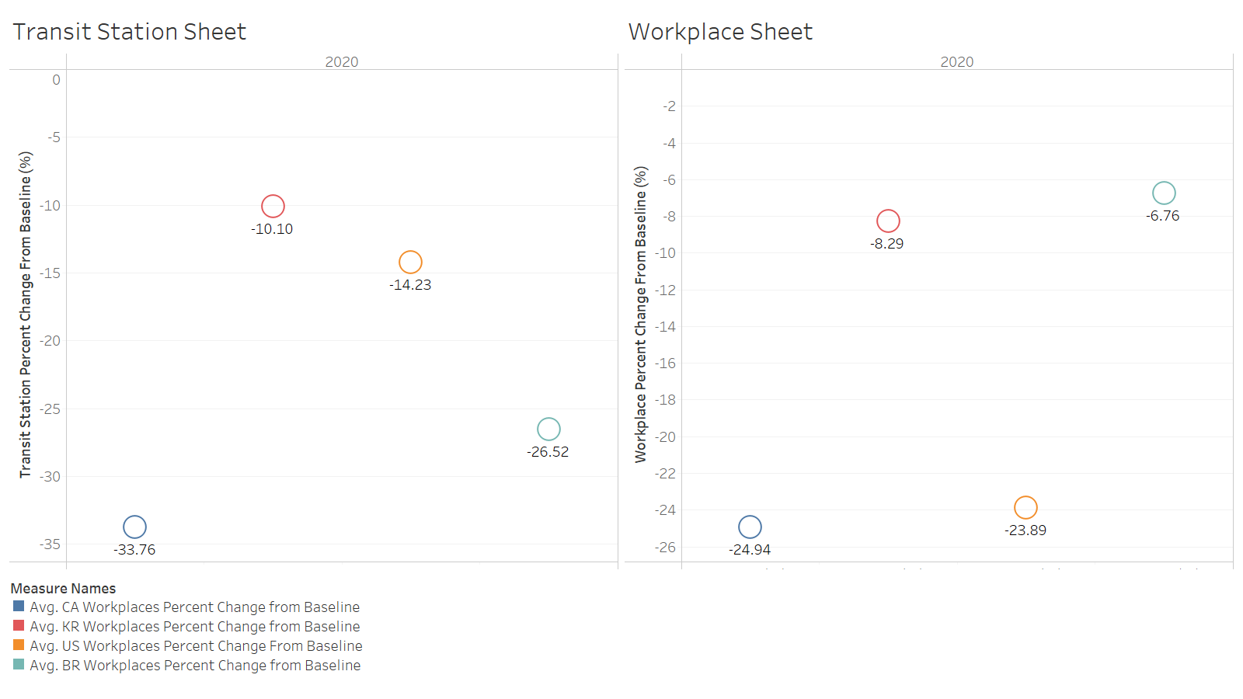

Slide 37




SUMMARY
High Mobility, Low Recovery
High Mobility, High Recovery
Low Mobility, Low Recovery
Low Mobility, High Recovery

Slide 38
Question 3

Slide 39
See what was trending in 2020
1) Coronavirus 2) Election results 3) Kobe Bryant 4) Zoom 5) IPL 6) India vs New Zealand 7) Coronavirus update 8) Coronavirus symptoms 9) Joe Biden 10) Google Classroom

Slide 40
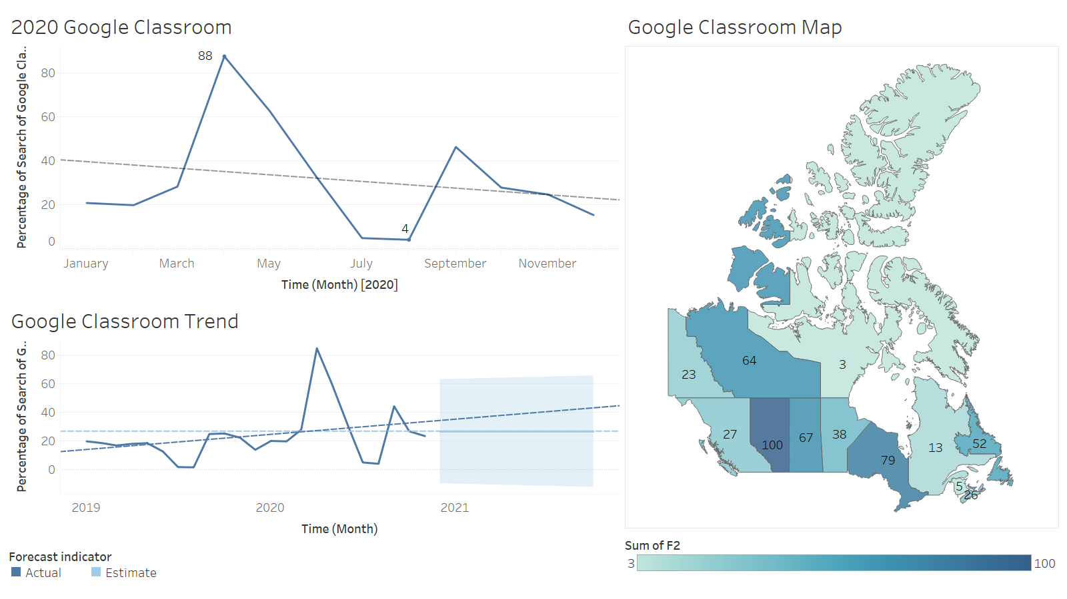

Slide 41
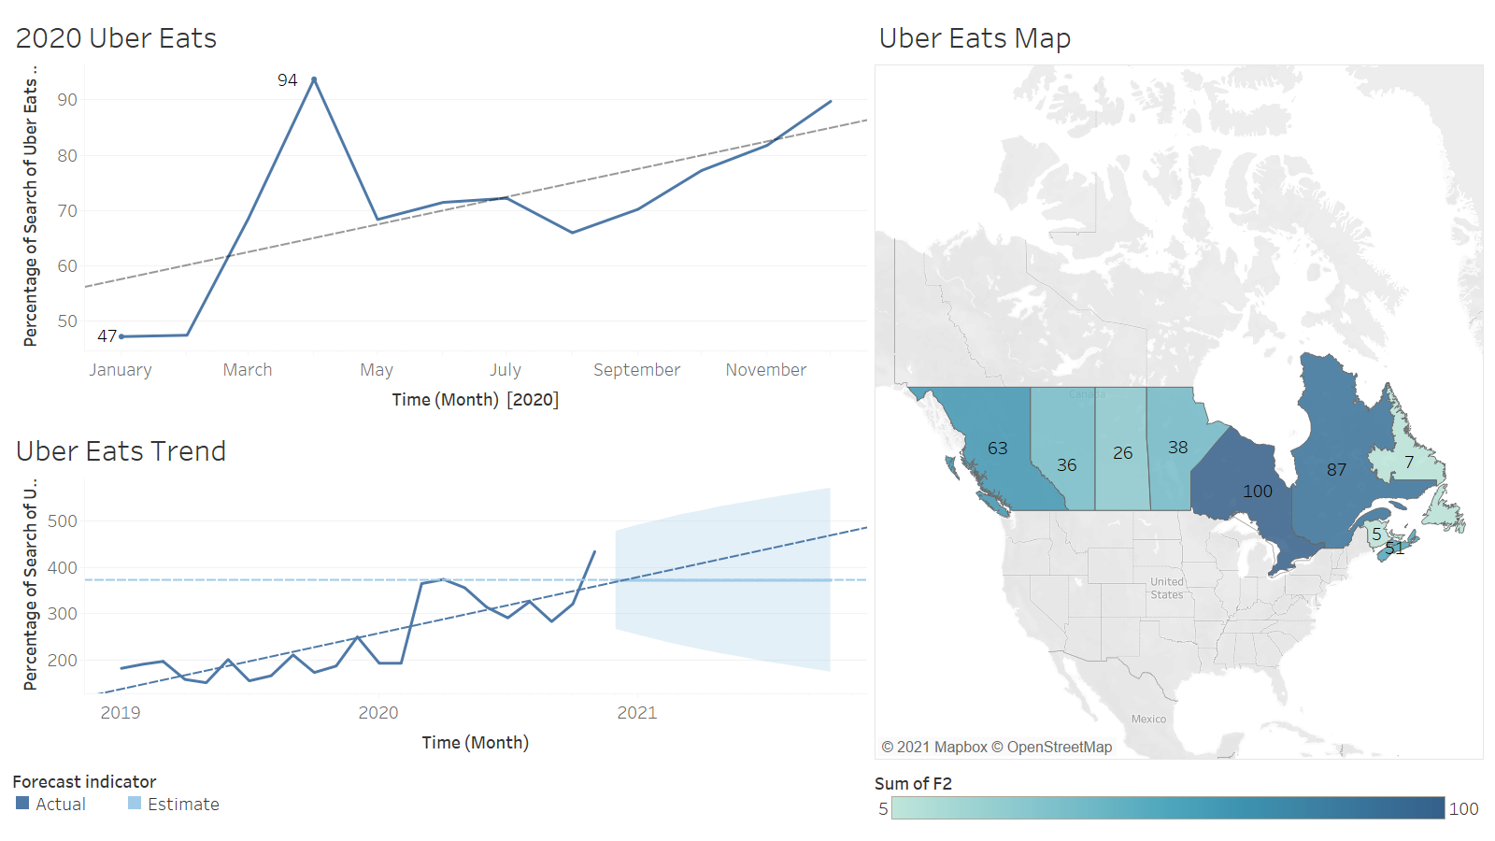

Slide 42
Work cited
“A Framework for Reopening Our Province: Stage 3.” Ontario.ca, 2021, www.ontario.ca/page/framework-reopening-our-province-stage-3. Accessed 18 Apr. 2021.
ALERT LEVEL YOUR RESPONSIBILITY PUBLIC HEALTH MEASURES ALL.
CBC News. “A Year of COVID-19: Milestones and Moments in an Unforgettable Year | CBC News.” CBC, 14 Mar. 2021, www.cbc.ca/news/canada/newfoundland-labrador/milestones-moments-covid19-1.5946036.
Christiansen, Milt, et al. “Manitoba’s Plan for Reopening Businesses - MLT Aikins - Western Canada’s Law Firm.” MLT Aikins, 13 Nov. 2020, www.mltaikins.com/covid-19/manitoba-announces-plan-for-reopening-businesses/. Accessed 18 Apr. 2021.
“Coronavirus Source Data – WHO Situation Reports.” Our World in Data, ourworldindata.org/coronavirus-source-data.
“COVID-19 Community Mobility Report.” COVID-19 Community Mobility Report, www.google.com/covid19/mobility/.
Engagement, Government Communications and Public. “BC’s Restart Plan.” Www2.Gov.bc.ca, www2.gov.bc.ca/gov/content/covid-19/info/bc-restart-plan#move-phases. Accessed 18 Apr. 2021.
“Google Trends.” Google Trends, trends.google.com/trends/?geo=CA. Accessed 18 Apr. 2021.
Juric, Sam. “Province Outlines ‘Carefully Constructed’ 1st Phase of COVID-19 Ease Back Plan | CBC News.” CBC, 28 Apr. 2020, www.cbc.ca/news/canada/prince-edward-island/pei-covid-19-updates-april-28-1.5547855.
Modjeski, Morgan. “COVID-19 in Saskatchewan: Five-Phase Plan to Reopen Province Set to Begin May 4 | CBC News.” CBC, 23 Apr. 2020, www.cbc.ca/news/canada/saskatchewan/province-pandemic-reopen-plan-1.5542461.

